Slide 1
Medical Image Analysis: Beyond Classification
Matthew Engelhard
Notes:
NEED INFO ABOUT ROC, CONFUSION MATRIX, ETC HERE

Slide 2
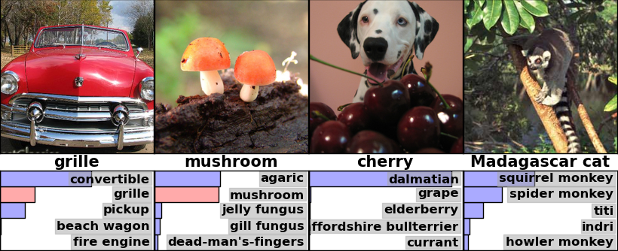
Which label is best?

Slide 3
Detection: propose regions
and predict their labels
Notes:
- Description
Typically smaller number of classes compared to classification
Result is distribution over output classes for each region
Higher annotation cost

Slide 4
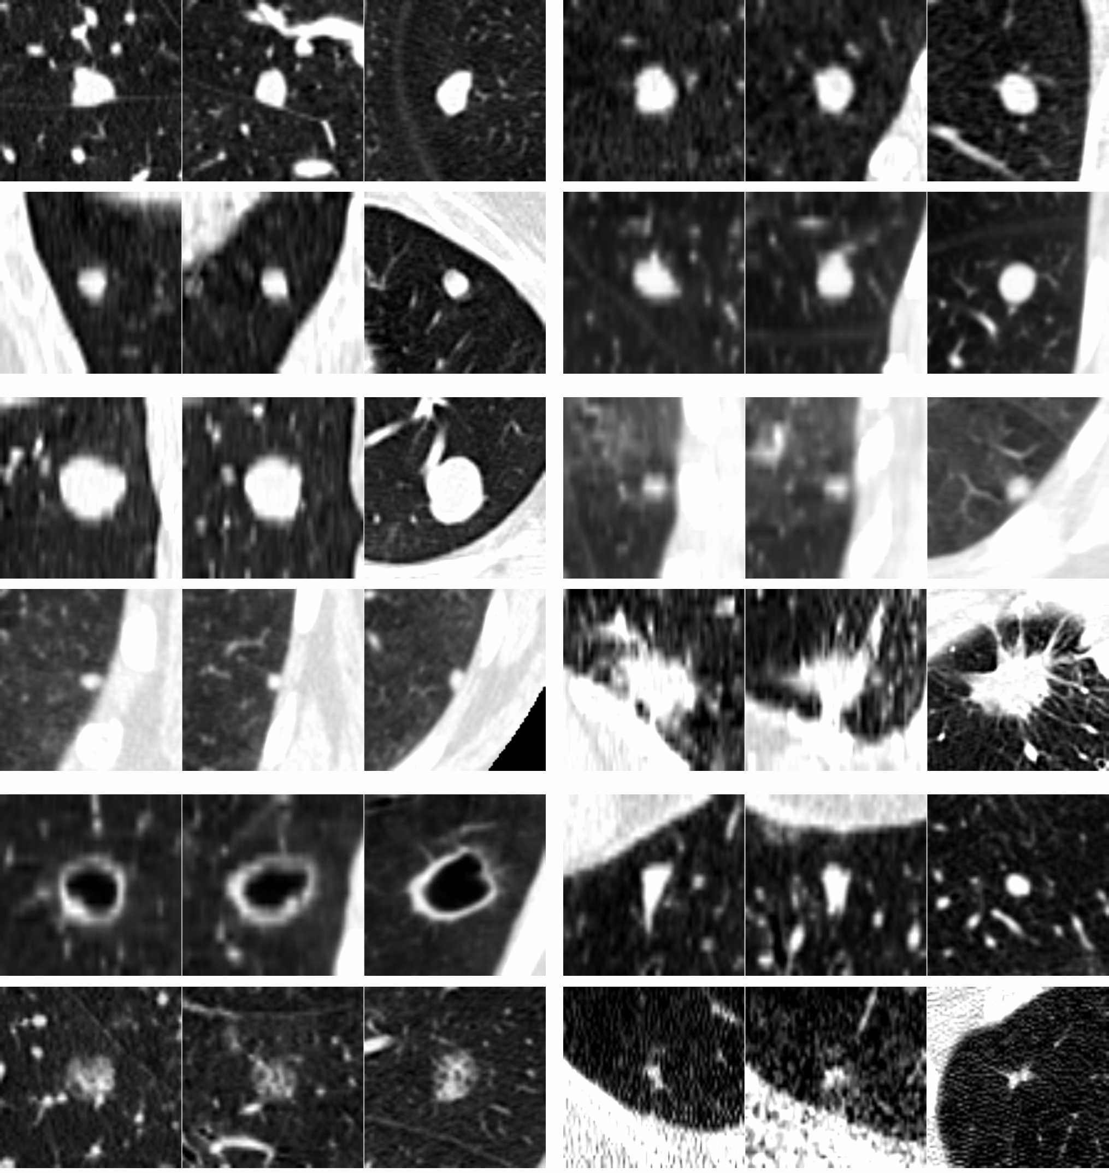
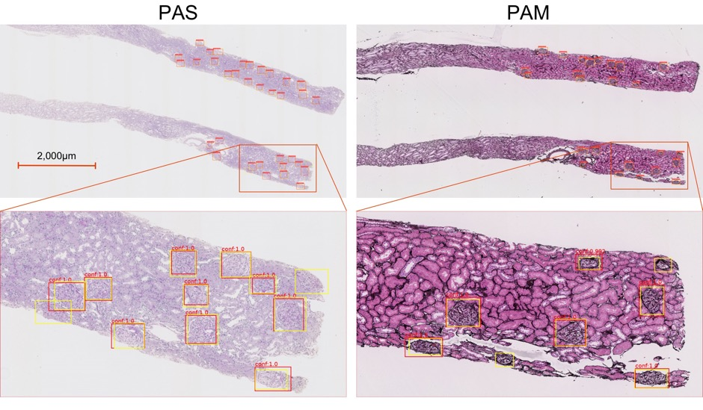
Detection in medicine
Glomerular Detection with Faster-RCNN
Pulmonary Nodule detection in CT
Kawazoe et al., J. Imaging, 2018
van Ginneken et al., Biomedical Imaging, 2015
Notes:
Adenoid cystic carcinoma (ACC) nodules (metastases)

Slide 5
Segmentation: predict the label for each pixel
Notes:
Very high annotation cost, although can be mitigated with good tools for drawing contours
Note that it does not distinguish between distinct objects belonging to the same class (e.g. multiple chairs); newer models have been developed to deal with this

Slide 6
Segmentation of optic disc, fovea and retinal vasculature Journal of Computational Science, 20, 70-79 (2017).
Notes:
… to identify the boundaries of specific structures or regions within the retina
Identify the optic disc, the fovea, the blood vessels
When we do this, we are partitioning the image into classes
Or, view as predicting the label associated with each pixel
This is segmentation
It has also been used very effectively in medical applications
It is also primarily done with CNNs.

Slide 7
Precisely Identify Boundaries

Slide 8
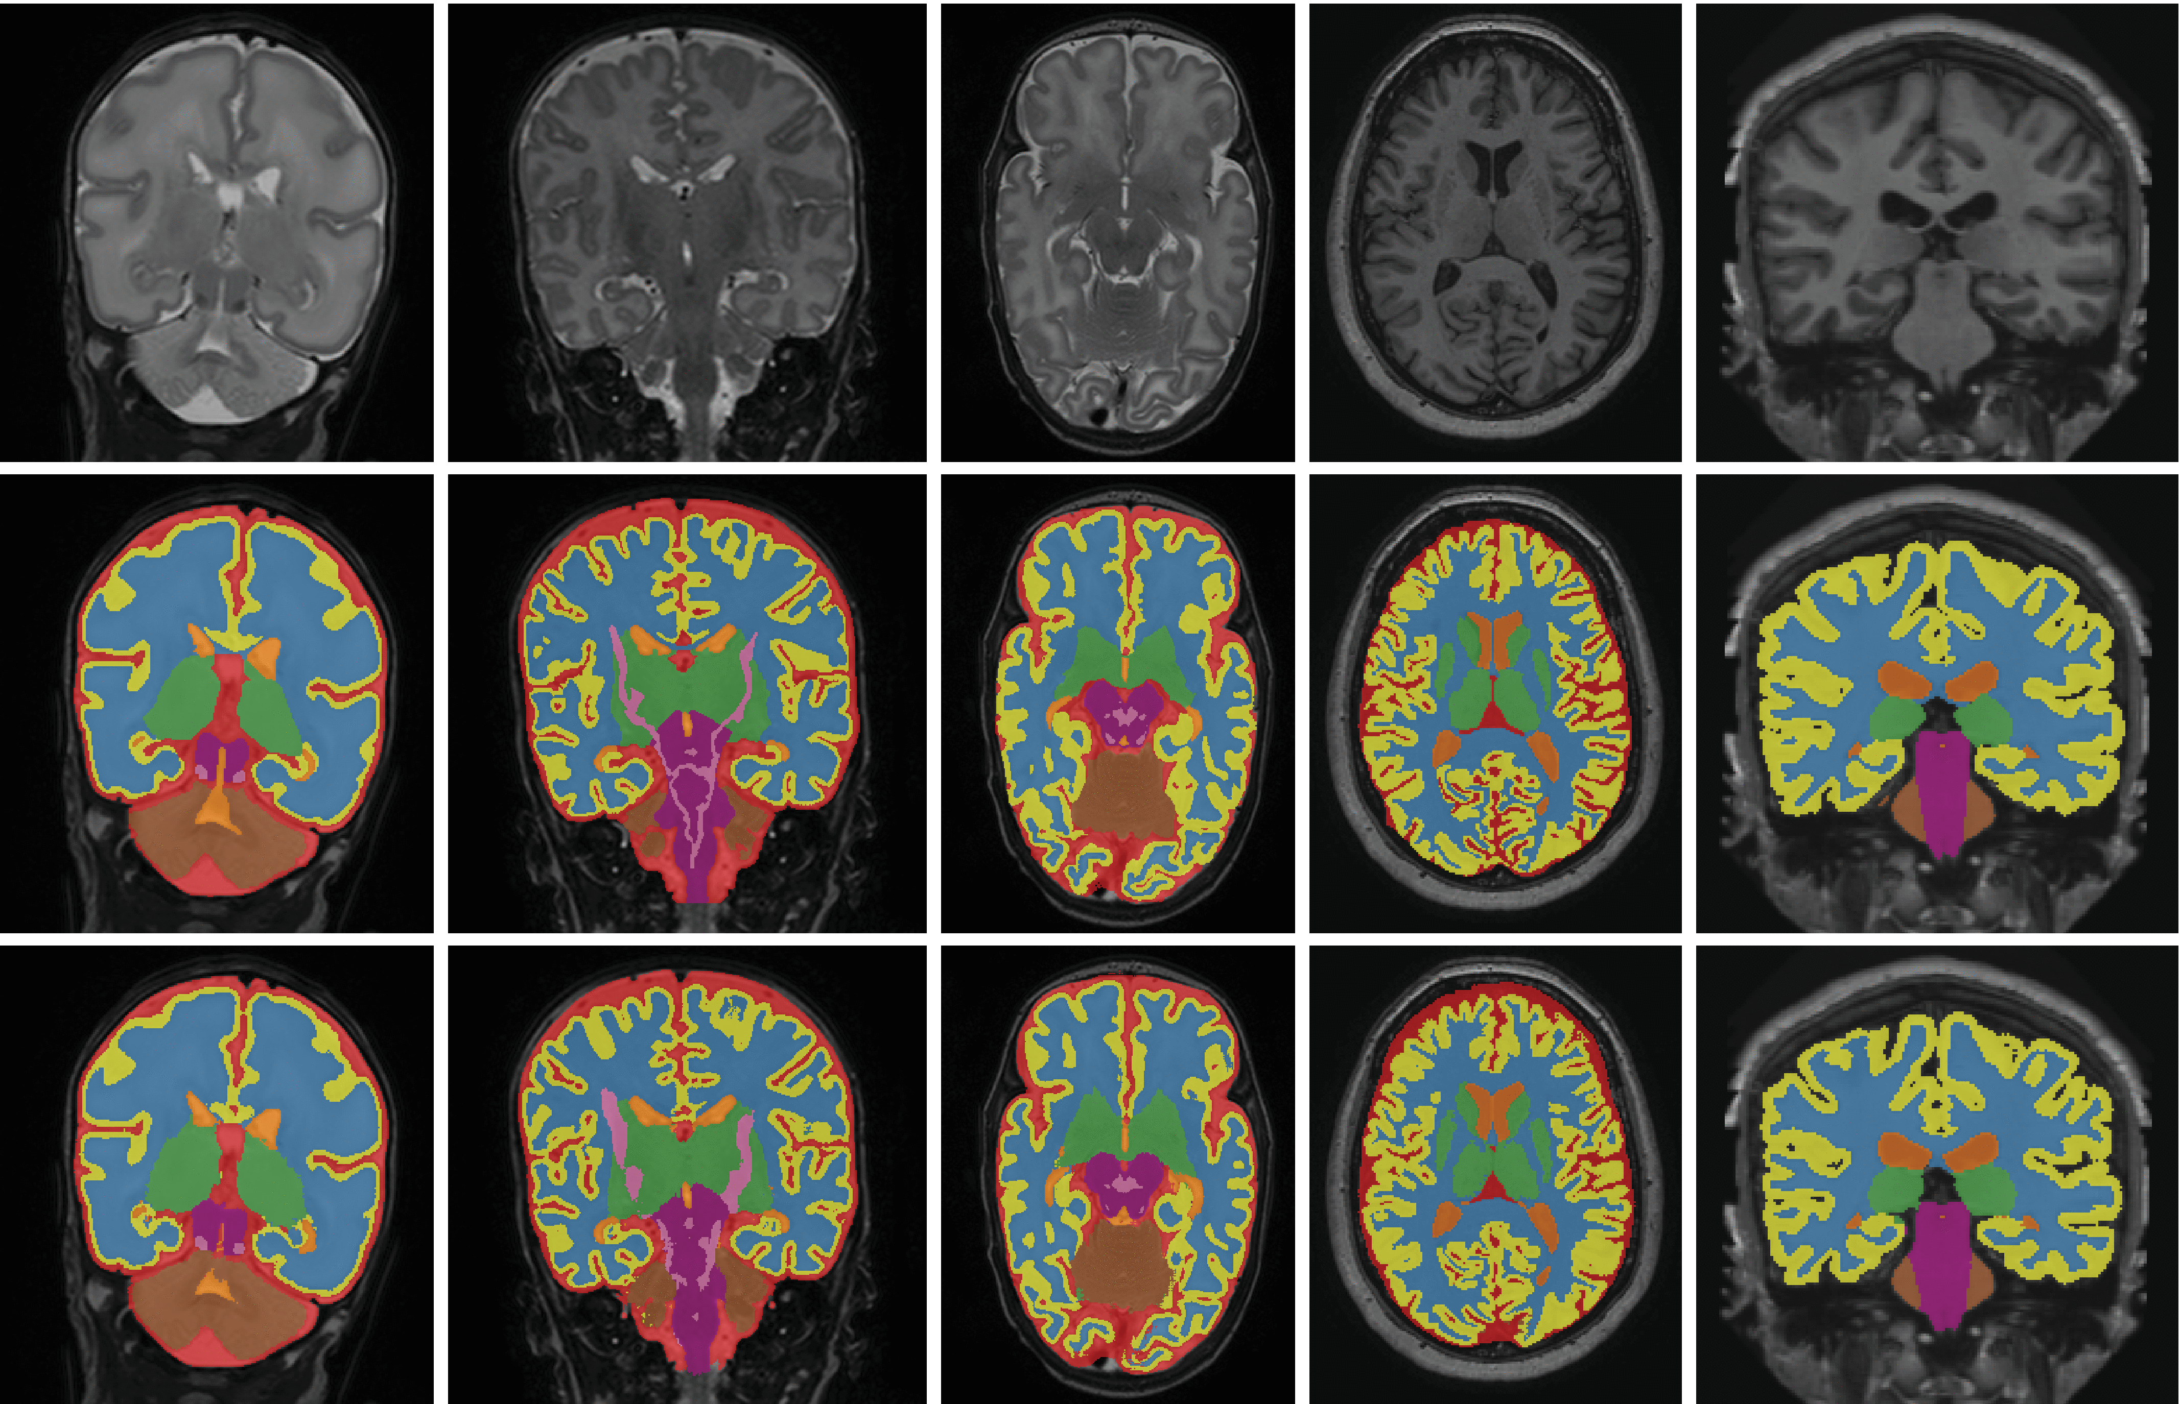
Determine Areas or Volumes
Notes:
Discuss lesion burden in MS
Tumor burden
Cardiomyopathy
Grey matter / white matter volume / volume of midbrain structures
Limit measures to specific structures

Slide 9
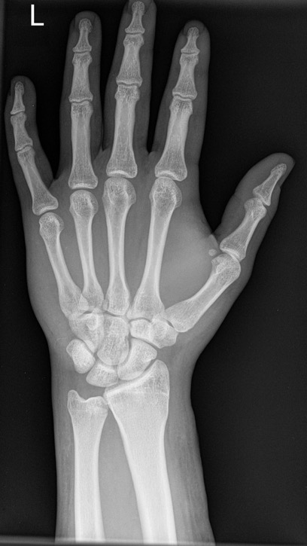
Segmentation-based features when end-to-end classification is not feasible
Segment
Bones
Calculate lengths and areas
Simple Classifier for Genetic or Growth Disorder

Slide 10

Colon Polyp Segmentation
Notes:
Show segmentation of polyps and briefly describe the clinical problem (why this matters) [10 min]
What is segmentation [15 min]
Why segment (compared to classification, detection) [5-10 min]
How does it work: two illustrative (and successful) architectures (seg-net, u-net) [10-15 min]
Evaluation of polyp segmentation / detection [10 min]
Brief discussion [<10 min]

Slide 11
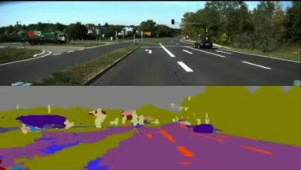
Approach: Start with SegNet (2015)

Slide 12
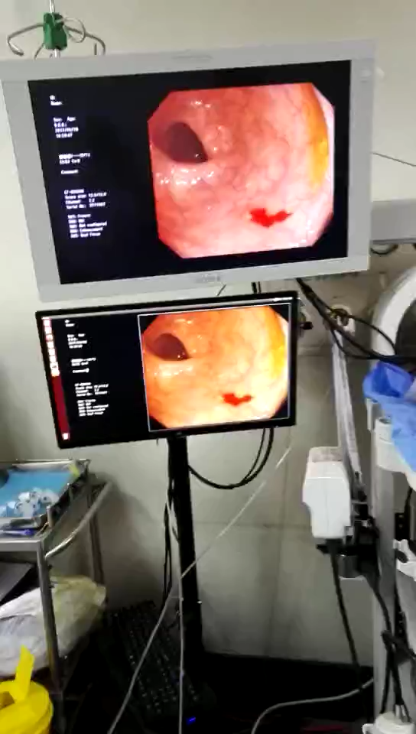
Retrain to segment polyps in real time

Slide 13
Segmentation in Brief
(Additional Material)
Notes:
<35 minute mark

Slide 14
Classification Architecture (VGG)
Notes:
Note that this is the first half of Segnet
Visual geometry group (VGG), oxford

Slide 15
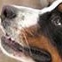
A separate classifier for each pixel?
y, associated value or label
x, data/features
End goal: predict y from x
Notes:
How does a single pixel make it a dog or not a dog?
Now imagine you don’t even know how to spot it yourself (e.g. in medical images)
Second idea: convolutional neural network with same spatial scale throughout: too many parameters!

Slide 16
Segmentation Architecture
SegNet (2015): fully convolutional architecture
Notes:
Encoder is first 13 layers of VGG
unpack this description
Each encoder layer has a corresponding decoder layer and hence the decoder network has 13 layers. The final decoder output is fed to a multi-class soft-max classifier to produce class probabilities for each pixel independently.

Slide 17
Stage 1: Encoder identifies features
Stage 2: Decoder reconstructs the spatial map
Alternative architectures differ in their approach
to the spatial reconstruction process

Slide 18
Stage 1: Encoder identifies features
Stage 2: Decoder reconstructs the spatial map
Segnet’s approach to reconstruction: remember max-pooling indices

Slide 19
SegNet decoder overview
Remember max pooling indices
Use max pooling indices
3 | 1 | 3 | 7
2 | 5 | 3 | 4
1 | 4 | 3 | 1
1 | 2 | 2 | 5
0 | 0 | 0 | 4
0 | 3 | 0 | 0
0 | 8 | 0 | 0
0 | 0 | 0 | 2
5 | 7
4 | 5
3 | 4
8 | 2
Convolution with trainable decoder filters
Other
Layers
Notes:
Talk about options here.
When we max-pool, we are remembering the most salient features; i.e. the best matches
If we want to reconstruct the original map, we should remember where these features are located

Slide 20
A Highly Successful Architecture: U-Net
Notes:
Primary differences:
1) upconvolution instead of upsampling w/pooling indices
2) append feature map from corresponding encoder

Slide 21
Concatenation of corresponding encoder feature map
Notes:
Concatenation of feature map from corresponding encoder
Adjustment for padding: take center of appropriate size

Slide 22
SegNet: Upsampling w/ Stored Pooling Indices
U-Net: 2x2 Upconvolution
0 | 0 | 0 | 4
0 | 3 | 0 | 0
0 | 8 | 0 | 0
0 | 0 | 0 | 2
3 | 4
8 | 2
3 | 4
8 | 2
1 | 3
2 | 1
Learned filter
Notes:
Double check with Justin – no overlap in field?
Note that this does not deal with depth / feature space, which is halved with each upconvolution

Slide 23
SegNet: Upsampling w/ Stored Pooling Indices
U-Net: 2x2 Upconvolution
0 | 0 | 0 | 4
0 | 3 | 0 | 0
0 | 8 | 0 | 0
0 | 0 | 0 | 2
3 | 9
6 | 3
3 | 4
8 | 2
3 | 4
8 | 2
1 | 3
2 | 1
Learned filter
Notes:
Double check with Justin – no overlap in field?
Note that this does not deal with depth / feature space, which is halved with each upconvolution

Slide 24
SegNet: Upsampling w/ Stored Pooling Indices
U-Net: 2x2 Upconvolution
0 | 0 | 0 | 4
0 | 3 | 0 | 0
0 | 8 | 0 | 0
0 | 0 | 0 | 2
3 | 9 | 4 | 12
6 | 3 | 8 | 4
3 | 4
8 | 2
3 | 4
8 | 2
1 | 3
2 | 1
Learned filter
Notes:
Double check with Justin – no overlap in field?
Note that this does not deal with depth / feature space, which is halved with each upconvolution

Slide 25
SegNet: Upsampling w/ Stored Pooling Indices
U-Net: 2x2 Upconvolution
0 | 0 | 0 | 4
0 | 3 | 0 | 0
0 | 8 | 0 | 0
0 | 0 | 0 | 2
3 | 9 | 4 | 12
6 | 3 | 8 | 4
8 | 24
16 | 8
3 | 4
8 | 2
3 | 4
8 | 2
1 | 3
2 | 1
Learned filter
Notes:
Double check with Justin – no overlap in field?
Note that this does not deal with depth / feature space, which is halved with each upconvolution

Slide 26
SegNet: Upsampling w/ Stored Pooling Indices
U-Net: 2x2 Upconvolution
0 | 0 | 0 | 4
0 | 3 | 0 | 0
0 | 8 | 0 | 0
0 | 0 | 0 | 2
3 | 9 | 4 | 12
6 | 3 | 8 | 4
8 | 24 | 2 | 6
16 | 8 | 4 | 2
3 | 4
8 | 2
3 | 4
8 | 2
1 | 3
2 | 1
Learned filter
Notes:
Double check with Justin – no overlap in field?
Note that this does not deal with depth / feature space, which is halved with each upconvolution

